Slide 1
205, Nov 13, Class 21
Final projects
  Start building your procedure online
Ethics 2: Responsible Conduct of Research

Slide 2
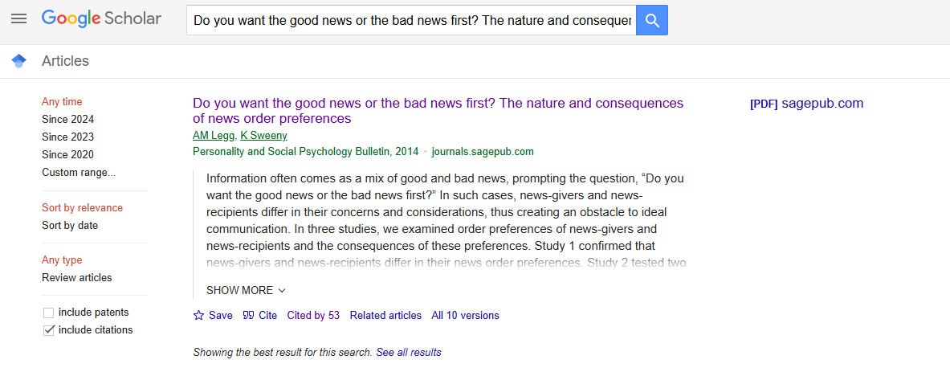
Background research
Missing Find @ NU link
Preformatted reference
Articles that cite your main source.

Slide 3
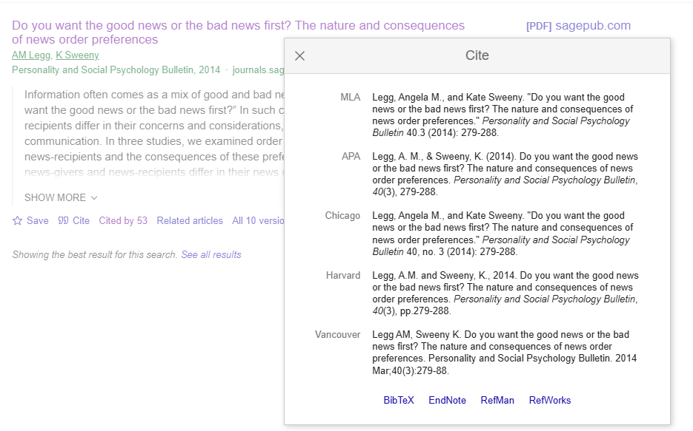

Slide 4
Vaccine skepticism
In 1998, Andrew Wakefield and 12 of his colleagues published a case series in the Lancet, which suggested that the measles, mumps, and rubella (MMR) vaccine may predispose to behavioral regression and pervasive developmental disorder in children.
Despite the small sample size (n=12), the uncontrolled design, and the speculative nature of the conclusions, the paper received wide publicity, and MMR vaccination rates began to drop because parents were concerned about the risk of autism after vaccination.

Slide 5
Taylor et al (1999) examined 498 cases of autism
  There was no difference in age at diagnosis between the cases vaccinated before or after 18 months of age and those never vaccinated.
  There was no temporal association between onset of autism within 1 or 2 years after vaccination with MMR (relative incidence compared with control period 0.94 [95% CI 0.60-1.47] and 1.09 [0.79-1.52]).
Lancet (2004) reviewed allegations against Wakefield
  Acknowledged that Wakefield had a significant “conflict of interest”
  Dismissed allegations of improper recruiting, patient selection

Slide 6
Full Investigation
Wakefield was paid over £400k by lawyers trying to sue vaccine companies in the two years before the study
  Had already asserted a vaccine/bowel/autism link before data were collected
  Written communication asked him to find a “temporal link”
Analysis of the 12 patients revealed none matched their actual medical records
  Patients mostly knew each other and were recruited due to vaccine concerns and were pre-interviewed for consistency with the hypothesis before enrolling in study
  Several had documented symptoms pre-dating vaccination (developmental delays and/or GI problems)
  Data linking the time from vaccination to diagnosis were incorrect, inconsistent data were excluded
Full retraction of the paper from Lancet in 2010
  Wakefield lost medical license

Slide 7
Research Integrity
Brian Deer, journalist, did most of the investigation uncovering the research fraud
  Funded by the Sunday Times of London and the Channel 4 television network.
  Reports by Deer in the BMJ were commissioned and paid for by the journal.
  No other funding was received, apart from legal costs paid to Deer by the Medical Protection Society on behalf of Andrew Wakefield.
  All claims in Deer’s articles consistent with investigation from the British General Medical Counsel assessed by editors at the British Medical Journal
Took 12 years to investigate, find fraud and retract paper

Slide 8
Responsible Conduct of Research
Researchers carry out research process with rigor and integrity
  Don’t lie, cheat or steal
Data Manipulation
  Forgery: fabrication or modification
  Data selection
    Eliminating all data inconsistent with the hypothesis
  Bias in recruiting, protocol administration or data scoring

Slide 9
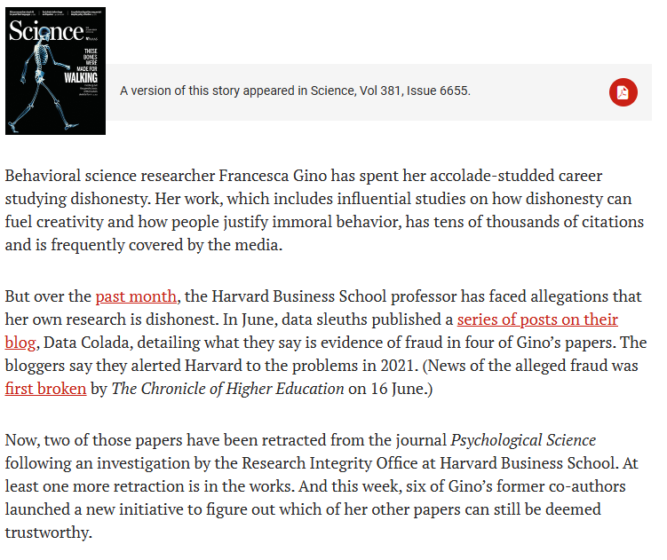
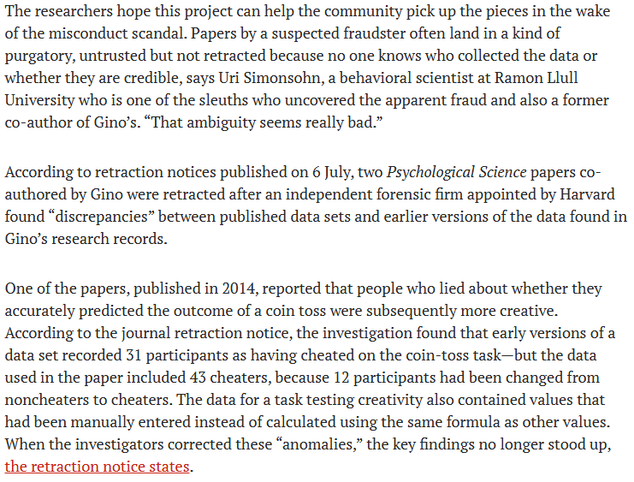

Slide 10
Analytic Flexibility
File drawer effect
  Re-running or re-starting the experiment repeatedly until it “works”
“p-hacking”
  Trying different analysis approaches until it “works”
Normal processes that seem similar
  Pilot testing
  Data exploration
  Standard exclusion/filtering processes
  When is it too much?

Slide 11
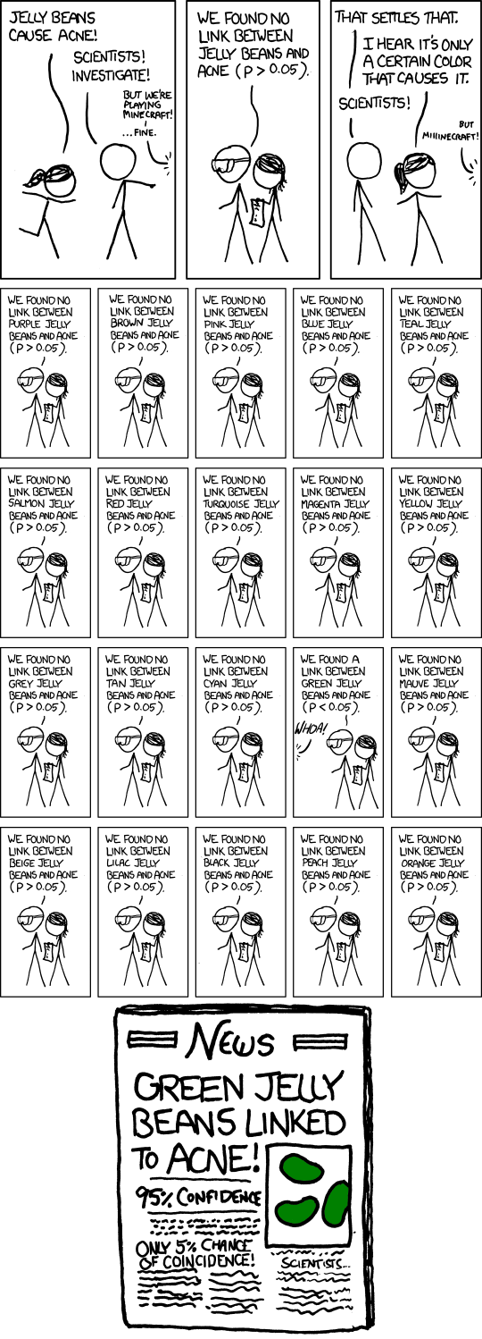

Slide 12
Reproducibility
Research that meets the p<.05 statistical criterion should replicate if repeated
  Except for power issues or generalizability questions or new extraneous variables or unlucky variance or imprecise protocol following…
Weak processes for research rigor make this less likely
  Even typical lab processes risk inflating the estimated effect size
Replication crisis approaches
  More rigor, fewer studies with greater confidence
  More studies without increasing rigor, build in replications

Slide 13
Plagiarism
Citation strengthens reports
  Novel findings have value
  Build on existing ideas
Actual appropriation of others’ ideas is rare
  Scooping other labs
  Pre/re publishing manuscripts
Authorial credit to collaborators and research team
  Significant intellectual contribution
  Definition varies across psychology, medicine for example
  Not uncommon source of in-laboratory friction

Slide 14
Transparency: Being Public
All aspects of the research process are auditable
  Participant privacy must still be protected
  Researchers protected from exposure to competing labs
  Patent, copyright, and invention privacy
Publication
  Full, fair & accurate reporting, making all resources available
    Not always practically effective
  Supplementary materials via journal website
  Public availability of de-identified data
    Does not always include excluded data

Slide 15
RCR Errors
Suppose a friend doing a research project said to you, “I’m sure my hypothesis is correct, so I’ll just give my participants a hint here and there to make sure the data come out properly.”
What kind of RCR violation is this?
What methodological approach should be used by this research to avoid this problem?

Slide 16
RCR Errors
A researcher doing a study on academic performance of students who have been diagnosed with ADHD. Some of the potential participants have refused to answer the question about their diagnosis, so the researcher contacts their medical provides without the participant’s knowledge.
What kind of research ethics violation has occurred here?

Slide 17
Intervention research
Give an example of a research study not included in the chapter for which it would be unethical to include a placebo/control group.
Why are rules requiring reporting of conflict of interest important for ensuring accurate and fair scientific processes and reports?

Slide 18
Curing cancer
Suppose we have a new drug that we think cures cancer. We need to prove it works so we can confidently give it to all cancer patients.
Research study
  Set up a fully double-blind design
  Recruit participants who are cancer patients
  IV = ???
  DV = ???
  What if the pharmaceutical company wants to sponsor the research?

Slide 19
Philosophical Ethical Challenges
When the experimental treatment is a benefit
  Justice would normally mean equal benefits across groups
  Intervention research on Monday
Coercion versus voluntary participation
  Authority figures: supervisors, teachers
  Financial rewards: incentivizing risk
Vulnerable populations
  Children: depend on guardian
    Mandatory reporting training for staff
  Prisoners: cannot voluntarily consent
    Research must be for prisoners’ benefit

Slide 20
For Fri Nov 15
Chapter 19: Applied research
Upcoming
  Monday, Chapter 20
    Developmental psychology and Neuropsychology
  Wednesday, Exam 2
  Project presentations Friday 11/22 and Monday 11/25

